Slide 1
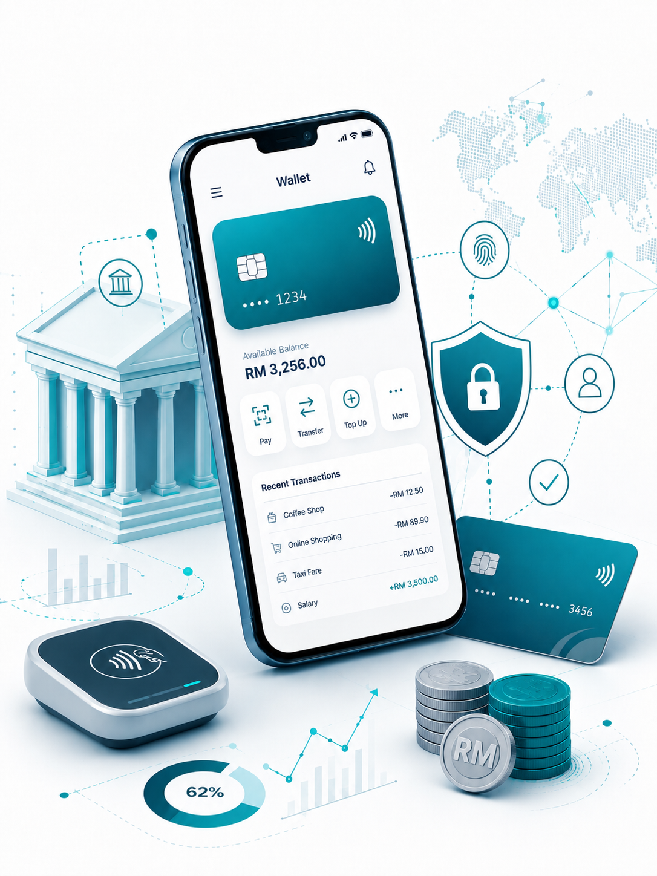

Insert relevant picture related to the topic
TFB3323 FINTECH INNOVATION
WEEK II
FINANCIAL INCLUSION
Shuhaida Bt M Shuhidan
(Dr (FSMC/UTP))
BACHELOR OF XXXXXX
DEPARTMENT OF COMPUTING
FACULTY OF SCIENCE, MANAGEMENT & COMPUTING
© 2026 INSTITUTE OF TECHNOLOGY PETRONAS SDN BHD
All rights reserved. No part of this document may be reproduced, stored in a retrieval system or transmitted in any form or by any means (electronic, mechanical, photocopying, recording or otherwise) without the permission of the copyright owner.

Slide 2
RECAP FROM PREVIOUS LECTURE
The Core of FinTech: It merges financial services with modern technology to offer faster, cheaper, and more accessible alternatives to traditional banking.
The Power of "Unbundling": Instead of trying to be a one-stop shop, FinTech startups break apart traditional bank services to focus on doing one specific thing exceptionally well.
Main Growth Drivers: The industry's rise is fueled by the shift to mobile tech, AI, changing consumer expectations (especially from millennials), and the need to reach underbanked populations.
Shared Industry Hurdles: Traditional banks struggle to adapt their legacy systems to new competition, while FinTechs face tough challenges with complex regulations, cybersecurity, and scaling their customer base.
A Global Boom: FinTech investment has skyrocketed globally, with Asia (specifically China and the ASEAN region) standing out as a massive hub for digital innovation and "unicorn" companies.
Notes:
Learning Outcomes Slide
Note:
Include 2–4 lecture-level learning outcomes
Use measurable action verbs
Map explicitly to Course Learning Outcomes (CLOs)

Slide 3
LEARNING OUTCOMES
By the end of this session, students will be able to:
Understand the FinTech Ecosystem: Identify the key parts of the ecosystem, such as demand, talent, capital, policy, and solutions.
Identify the Unbanked and Underbanked: Define who lacks access to traditional banking, why they are excluded , and how millennials are driving the demand for new solutions.
Define Financial Inclusion: Grasp the main goals of making financial services accessible, affordable, relevant, easy to use, and high quality for everyone.
Evaluate Digital Financial Services (DFS): Learn how digital tools lower costs, boost economic growth, and make banking available to more people.
Analyze Barriers to Inclusion: Recognize the challenges stopping financial inclusion from both the customer side (demand) and the provider side (supply).
Examine Real-World Impact: See how FinTech companies like Ant Financial have successfully used digital tools to reduce poverty and improve financial access in China.
Notes:
Learning Outcomes Slide
Note:
Include 2–4 lecture-level learning outcomes
Use measurable action verbs
Map explicitly to Course Learning Outcomes (CLOs)

Slide 4
TOPICS
Financial Ecosystem & Infrastructure?
1.1. FinTech Ecosystem Stakeholders
1.2. Ecosystem Components (Demand, Talent, Capital, Policy, Solutions)
2. Unbanked, Underbanked & the Millennials?
2.1. Defining the Unbanked and Underbanked ?
2.2. Reasons for Financial Exclusion?
2.3. Millennials: Digital Natives & the 'No-Wait Generation’ ?
2.4. Unbanked & Underbanked Populations in ASEAN
Financial Inclusion & Digital Financial Services (DFS)
3.1. What is Financial Inclusion?
3.2. Key Components of Financial Inclusion
3.3. The Role and Benefits of Digital Financial Services
3.4. The Secret to Success
3.5. Financial Innovations: Information and Communication
3.6. New Types of Information for Credit Worthiness
Constraints to Financial Inclusion
5.1. Demand-Side Constraints (Income, Geography, Documentation, Literacy)
5.2. Supply-Side Constraints (Operating Costs, Legacy Models, Limited Competition)
Notes:
Engagement and Activity Slides
Note:
Include at least one engagement element where appropriate:
Think–Pair–Share
Mini task
Poll or reflection question
Suggested duration: 3–5 minutes
Activities shall align with learning outcomes

Slide 5
TOPICS
China, Fintech and Financial Inclusion
5.1. How FinTech has Helped Reduce Poverty
5.2. Case Study: Ant Financial and Sesame Credit
5.3. Social and Economic Impacts of FinTech in China
5.4. Why China's FinTech Sector is Successful
Notes:
Engagement and Activity Slides
Note:
Include at least one engagement element where appropriate:
Think–Pair–Share
Mini task
Poll or reflection question
Suggested duration: 3–5 minutes
Activities shall align with learning outcomes

Slide 6
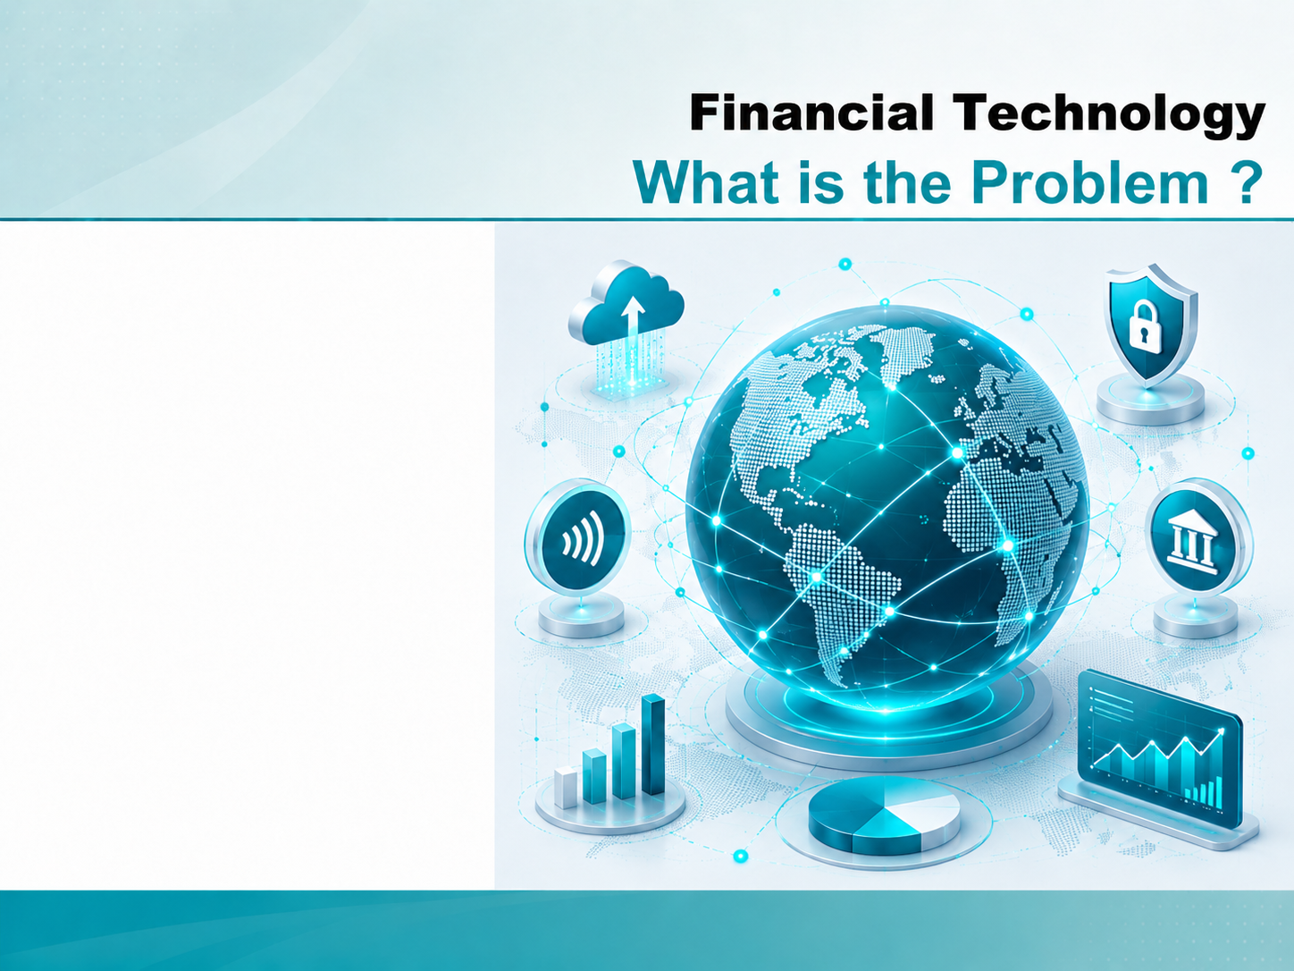
INTRODUCTION TO FINTECH
Financial Inclusion

Slide 7
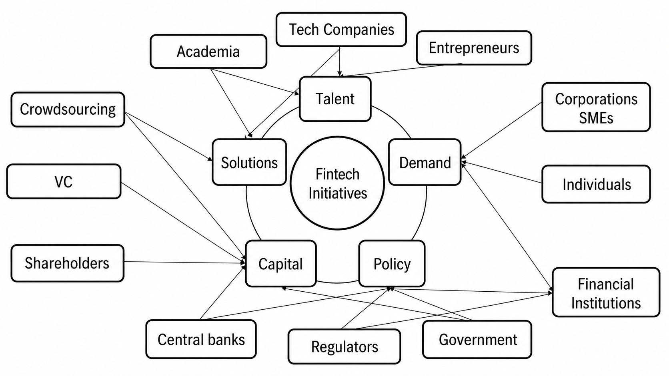
FinTech Ecosystem & Stakeholders
Notes:
Engagement and Activity Slides
Note:
Include at least one engagement element where appropriate:
Think–Pair–Share
Mini task
Poll or reflection question
Suggested duration: 3–5 minutes
Activities shall align with learning outcomes

Slide 8
FinTech Ecosystem & Stakeholders
1.1. FinTech Ecosystem
Fintech ecosystems are collections of organisations working together to reach a common goal. In financial services, this usually refers to the development and adoption of new technologies to improve or disrupt the traditional banking sector.
Fintech ecosystems improve the industrial development of the industry by providing an environment where fintech companies, financial institutions and regulators can collaborate. This helps improve the quality of products and services offered and allows for the sharing knowledge and best practices.
Notes:
Engagement and Activity Slides
Note:
Include at least one engagement element where appropriate:
Think–Pair–Share
Mini task
Poll or reflection question
Suggested duration: 3–5 minutes
Activities shall align with learning outcomes

Slide 9
FinTech Ecosystem & Stakeholders (FinTech Ecosystem)
Demand: the across consumers, corporates, and financial institutions.
Talent: the availability of technological, financial services, and entrepreneurial talents.
Capital: the availability of financial resources for statups and internal initiatives.
Policy: the government policies on regulations, taxes, and innovation initiatives.
Solutions: the introduction of new technology, products, services, and processes
Notes:
Engagement and Activity Slides
Note:
Include at least one engagement element where appropriate:
Think–Pair–Share
Mini task
Poll or reflection question
Suggested duration: 3–5 minutes
Activities shall align with learning outcomes

Slide 10
FINANCIAL
INCLUSION
Unbanked, Underbanked
and the Millennials

Slide 11
Unbanked, Underbanked & the Millennials
1.1. The Unbanked and Underbanked – Who
Who are the “unbanked” ? Those adults without an account at a bank or other financial institution and are considered to be outside the mainstream for one reason or another.
Unbanked persons generally pay for things in cash or else purchase money orders. Unbanked persons also typically do not have insurance, pensions or any other type of professional money-related services.
Who are the “underbanked” ?…. used to describe groups of people with a particular level of income who do not use all the financial services that those with that income would normally be expected to use.
Estimated 2.5 billion unbanked/underbanked in the world.
Notes:
Engagement and Activity Slides
Note:
Include at least one engagement element where appropriate:
Think–Pair–Share
Mini task
Poll or reflection question
Suggested duration: 3–5 minutes
Activities shall align with learning outcomes

Slide 12
Unbanked, Underbanked & the Millennials
FinTechs are offering:
They Solutions for customers unable to get loans with no or poor credit scores. No credit score -> makes them invisible to the mainstream financial system.
Peer-to-peer (P2P) marketplaces for customers unable to secure loans from the traditional sources
Personal finance management tools
No credit score….why is this important? Because a credit score → access to financial services—is usually necessary to buy a home, build a business, or send your children to college.
Notes:
Engagement and Activity Slides
Note:
Include at least one engagement element where appropriate:
Think–Pair–Share
Mini task
Poll or reflection question
Suggested duration: 3–5 minutes
Activities shall align with learning outcomes

Slide 13
Unbanked, Underbanked & the Millennials
1.1. The Unbanked and Underbanked – The Reasons
Lack of Money: Less money often means consumers can’t qualify for certain accounts that require a higher maintained balance.
Lack of Documentation Distrust. Impersonal service and negative past experiences.
Lack of Literacy. Lack of understanding about banks, rates and the benefits of maintaining an account
Blacklisted. Others also are unable to open an account if they have a negative financial history, such as bounced checks or excessive account overdrafts.
Inconvenience and Geographical Barriers. Some unbanked and underbanked consumers say their communicaties don’t have enough nearby bank branches to use them regularly. They also cite their limited hours of operations for those who work different. Shifts.
Notes:
Engagement and Activity Slides
Note:
Include at least one engagement element where appropriate:
Think–Pair–Share
Mini task
Poll or reflection question
Suggested duration: 3–5 minutes
Activities shall align with learning outcomes

Slide 14
Unbanked, Underbanked & the millennials
Millennials – Digital Natives & ‘No-Wait Generation’

Slide 15
Unbanked, Underbanked & the Millennials
1.1. Millennials – Digital Natives & ‘No-Wait Generation’
The most crucial he most crucial factor that helped FinTech become a disruptive force in the financial world is the millennial population.
Millennials or Generation Z are very demanding and less loyal as they expect personalized products and services according to their needs.
Demand from the Millennial generation to innovate and to think about financial services differently has been a major catalyst for the disruptive change in the finance industry.
Millennials were raised with the idea that the first place to learn something, share something, or buy something is the Internet.
Notes:
Engagement and Activity Slides
Note:
Include at least one engagement element where appropriate:
Think–Pair–Share
Mini task
Poll or reflection question
Suggested duration: 3–5 minutes
Activities shall align with learning outcomes

Slide 16
FINANCIAL
INCLUSION
Financial Inclusion

Slide 17
Financial Inclusion
1.1. What is Financial Inclusion ?
Financial inclusion refers to the efforts and policies aimed at making financial services accessible at affordable costs to all individuals and businesses, regardless of their personal net worth or company size. It's an important aspect of promoting overall economic and social development. Financial inclusion seeks to address and offer solutions to the constraints that exclude people from participating in the financial sector.
Notes:
Engagement and Activity Slides
Note:
Include at least one engagement element where appropriate:
Think–Pair–Share
Mini task
Poll or reflection question
Suggested duration: 3–5 minutes
Activities shall align with learning outcomes

Slide 18
What is Financial Inclusion?
Key components of financial inclusion include:
Accessibility: Ensuring that financial services are within reach for every member of society, especially those living in remote or underserved areas.
Affordability: Making sure that the costs of financial services are not prohibitive for low-income individuals.
Relevance: Offering financial products and services that meet the specific needs of diverse groups, including savings, loans, insurance, and payment services.
Usefulness and Usability: Ensuring that financial products are easy to understand and use, enabling people to make informed decisions about their finances.
Quality of Service: Providing customer service that helps users to access services effectively, including education on the use of financial products
Notes:
Engagement and Activity Slides
Note:
Include at least one engagement element where appropriate:
Think–Pair–Share
Mini task
Poll or reflection question
Suggested duration: 3–5 minutes
Activities shall align with learning outcomes

Slide 19
What is Financial Inclusion?
Financial inclusion initiatives often focus on the unbanked and underbanked populations, aiming to integrate them into the formal financial system. This can be achieved through traditional banking products tailored to their needs, microfinance, digital financial services like mobile money, and other innovative banking and financial solutions. The ultimate goal of financial inclusion is to empower individuals and businesses to improve their quality of life and contribute
Notes:
Engagement and Activity Slides
Note:
Include at least one engagement element where appropriate:
Think–Pair–Share
Mini task
Poll or reflection question
Suggested duration: 3–5 minutes
Activities shall align with learning outcomes

Slide 20
Unbanked, Underbanked & the Millennials
1.1. Unbanked & Underbanked In ASEAN
Singapore – Unbanked: 2 %; underbanked: 38 %;banked: 60 %
Malaysia – Unbanked: 15 %; underbanked: 40 %; banked: 45 %.
Thailand– Unbanked: 18 %; underbanked: 45 %; banked: 37 %.
Indonesia– Unbanked: 51 %; underbanked: 26 %; banked: 23 %.
Philippines– Unbanked: 65 % underbanked: 13 %; banked: 22 %.
Vietnam– Unbanked: 69 %; underbanked: 10 %; banked: 21 %.
Notes:
Engagement and Activity Slides
Note:
Include at least one engagement element where appropriate:
Think–Pair–Share
Mini task
Poll or reflection question
Suggested duration: 3–5 minutes
Activities shall align with learning outcomes

Slide 21
FINANCIAL
INCLUSION
Digital Financial Services (DFS)

Slide 22
Financial Inclusion & Digital-ID
1.1. Digital Financial Services (DFS)
Financial inclusion Digital financial services play a crucial role in modern economies and societies for several reasons, significantly enhancing financial inclusion, efficiency, and innovation.
Increased Financial Inclusion: Digital financial services make banking and financial transactions accessible to people in remote or underserved areas who might not have access to traditional banking facilities. This includes individuals in developing countries, contributing to reducing poverty and promoting economic empowerment.
Notes:
Engagement and Activity Slides
Note:
Include at least one engagement element where appropriate:
Think–Pair–Share
Mini task
Poll or reflection question
Suggested duration: 3–5 minutes
Activities shall align with learning outcomes

Slide 23
What is Financial Inclusion?
Lower Costs: Operating digitally reduces costs for financial institutions, savings that can be passed on to consumers in the form of lower fees. It also allows for small transaction sizes, making financial services more affordable to lower-income individuals.
Innovation and New Services: The digital financial ecosystem fosters innovation, leading to the development of new financial products and services that can cater to a wide range of needs, including microloans, insurance products, and investment solutions tailored to the needs of various demographic groups.
Notes:
Engagement and Activity Slides
Note:
Include at least one engagement element where appropriate:
Think–Pair–Share
Mini task
Poll or reflection question
Suggested duration: 3–5 minutes
Activities shall align with learning outcomes

Slide 24
What is Financial Inclusion?
Economic Growth: By facilitating smoother and more efficient transactions, digital financial services can contribute to economic growth. They enable businesses to operate more efficiently and help to create markets and opportunities for new types of businesses.
Transparency and Security: Digital transactions can offer greater security and transparency than cash transactions, reducing opportunities for corruption and theft. They also allow for easier tracking and management of personal finances.
Financial Literacy and Empowerment: The use of digital financial services can promote financial literacy and empowerment among users by providing them with tools and resources to manage their finances effectively.
Notes:
Engagement and Activity Slides
Note:
Include at least one engagement element where appropriate:
Think–Pair–Share
Mini task
Poll or reflection question
Suggested duration: 3–5 minutes
Activities shall align with learning outcomes

Slide 25
FinTech Ecosystem & Stakeholders
1.1. Financial Innovations
Fintech ecosystems Recent IMF and ECB (European Central Bank) staff research distinguishes two areas of financial innovation.
Innovation in Information new tools to collect, process and analyze data on customers. Mainly, the increase in use of new types of data coming from the digital footprint of customers’ various online activities—mainly for credit-worthiness analysis.
Innovation in Communication: new approaches to customer relationships and the distribution of financial products.
Notes:
Engagement and Activity Slides
Note:
Include at least one engagement element where appropriate:
Think–Pair–Share
Mini task
Poll or reflection question
Suggested duration: 3–5 minutes
Activities shall align with learning outcomes

Slide 26
FinTech Ecosystem & Stakeholders
1.1. New Types of Information
The most transformative information innovation is the increase in use of new types of data coming from the digital footprint of customers’ various online activities — mainly for credit-worthiness analysis.
Credit scoring using so-called hard information (income, employment time, assets and debts) is nothing new. Typically, the more data is available, the more accurate is the assessment.
Notes:
Engagement and Activity Slides
Note:
Include at least one engagement element where appropriate:
Think–Pair–Share
Mini task
Poll or reflection question
Suggested duration: 3–5 minutes
Activities shall align with learning outcomes

Slide 27
FinTech Ecosystem & Stakeholders
1.1. New Communication Channels
Communication innovation is driven by the variety of digital platforms in social media, mobile communication, and online shopping that have penetrated much of consumers’ everyday lives, thus increasing their digital footprint and the available data. Platforms like Amazon, Facebook or Alibaba incorporate more and more financial services into their ecosystems, enabling the rise of new specialized providers that compete with banks in payments, asset management, and financial information provision.
Credit scoring Technology again boosts an existing trend. The shift from in-person bank branch visits to remote, online communication generally improves customer convenience and makes financial intermediation more cost-efficient. It also boosts geographic competition among banks, which can now service more distant customers
Notes:
Engagement and Activity Slides
Note:
Include at least one engagement element where appropriate:
Think–Pair–Share
Mini task
Poll or reflection question
Suggested duration: 3–5 minutes
Activities shall align with learning outcomes

Slide 28
FINANCIAL
INCLUSION
Constraints to
Financial Inclusion

Slide 29
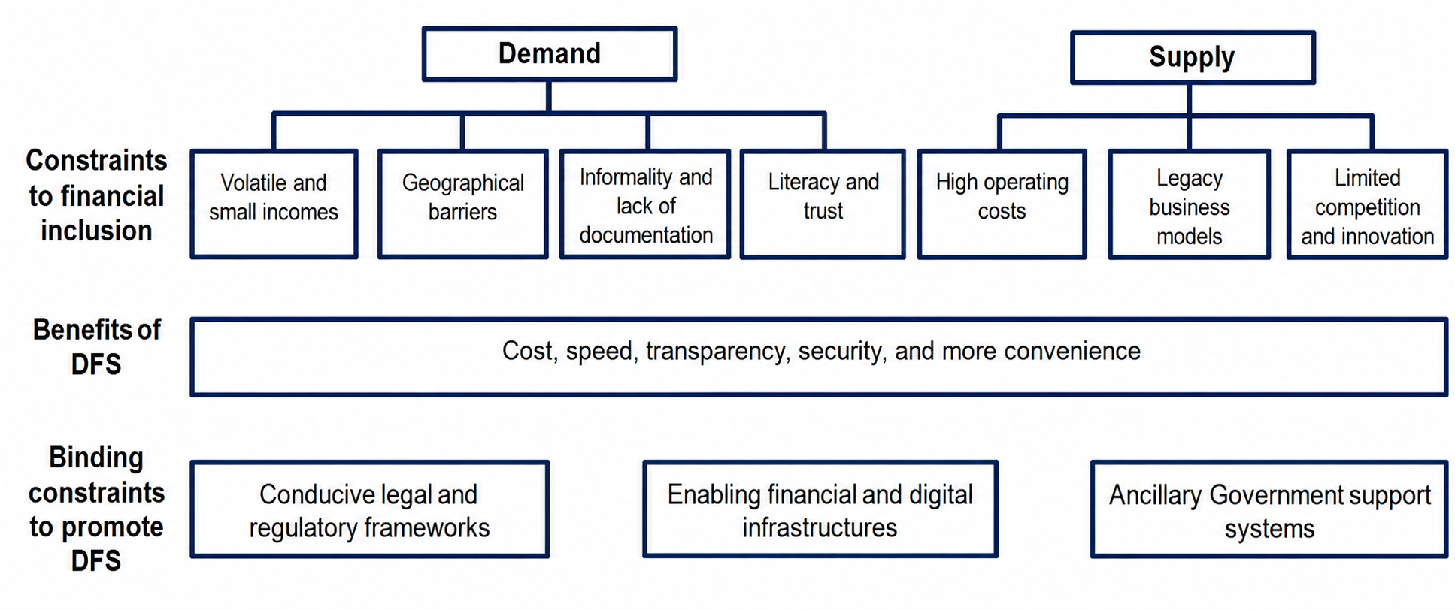
Constraints to Financial Inclusion and the Development of Digital Financial Service?
Notes:
Engagement and Activity Slides
Note:
Include at least one engagement element where appropriate:
Think–Pair–Share
Mini task
Poll or reflection question
Suggested duration: 3–5 minutes
Activities shall align with learning outcomes

Slide 30
Constraints to Financial Inclusion
Notes:
Engagement and Activity Slides
Note:
Include at least one engagement element where appropriate:
Think–Pair–Share
Mini task
Poll or reflection question
Suggested duration: 3–5 minutes
Activities shall align with learning outcomes

Slide 31
Constraints to Financial Inclusion (Demand Side)
Volatile and small incomes. The poor require affordable, low-value financial services that allow them to deal with small, unpredictable, incomes earned in the informal and agricultural sectors.
Geographical barriers. In developing economies, roughly one-fifth of adults without financial services cite distance to financial institutions as a barrier to account ownership.
Informality and lack of documentation. The poor often operate in the informal sector where they lack proper identity verification and leave little trace of their economic activity and assets
Literacy and trust. Poor, potential first-time users of formal financial services often lack awareness of financial services, as well as the skills to understand and responsibly use them. Indeed, those without financial services are more likely to be less educated, and almost a fifth cite distrust as a reason to refrain from using financial services
Notes:
Engagement and Activity Slides
Note:
Include at least one engagement element where appropriate:
Think–Pair–Share
Mini task
Poll or reflection question
Suggested duration: 3–5 minutes
Activities shall align with learning outcomes

Slide 32
Constraints to Financial Inclusion
Notes:
Engagement and Activity Slides
Note:
Include at least one engagement element where appropriate:
Think–Pair–Share
Mini task
Poll or reflection question
Suggested duration: 3–5 minutes
Activities shall align with learning outcomes

Slide 33
Constraints to Financial Inclusion (Supply Side)
High operating costs. Historically, many incumbents have operated expensive brick-and-mortar networks, maintained outdated core technologies, and relied on costly and time-consuming human and paper processes. These infrastructure and processing costs make small transactions and maintaining low-balance accounts unprofitable.
Legacy business models. Historically, many incumbents offered standardized financial services, which are more appropriate to serve more affluent individuals and larger companies. However, the poor who have volatile incomes may need more flexibility to extend payments, or to repay when cash is on hand, which may be the same day the loan was taken.
Limited competition and innovation. Historically, in many developing economies, incumbents have enjoyed considerable market power, protected by barriers to entry through restrictive regulations and a weak startup eco-system. As a result, these financial institutions were free to charge high fees and margins and felt less pressure to invest and innovate to tap into new and under-served market segments.
Notes:
Engagement and Activity Slides
Note:
Include at least one engagement element where appropriate:
Think–Pair–Share
Mini task
Poll or reflection question
Suggested duration: 3–5 minutes
Activities shall align with learning outcomes

Slide 34
FINANCIAL
INCLUSION
China, FinTech
&
Financial Inclusion

Slide 35
China, Fintech and Financial Inclusion
1.1. Ant Financial (China)
Ant Financial announced it was launching its own consumer credit scoring model: Sesame Credit, designed to leverage big data and customer behavior analytics to help make credit more available to millions. Sesame Credit is focused on those who may have little credit history.
Some people may have never obtained bank loans or applied for credit cards. However, it uses data from Alibaba's purchases, on time payment of their utility bills, stable residential status and mobile phone number history to compile it’s score. This could prove to be useful in countries where large segments of the population do not have bank accounts but do use other services.
Notes:
Engagement and Activity Slides
Note:
Include at least one engagement element where appropriate:
Think–Pair–Share
Mini task
Poll or reflection question
Suggested duration: 3–5 minutes
Activities shall align with learning outcomes

Slide 36
China, Fintech and Financial Inclusion
1.1. Ant Financial (China)
Ant Financial announced it was launching its own consumer credit scoring model: Sesame Credit, designed to leverage big data and customer behavior analytics to help make credit more available to millions. Sesame Credit is focused on those who may have little credit history.
Some people may have never obtained bank loans or applied for credit cards. However, it uses data from Alibaba's purchases, on time payment of their utility bills, stable residential status and mobile phone number history to compile it’s score. This could prove to be useful in countries where large segments of the population do not have bank accounts but do use other services.
Notes:
Engagement and Activity Slides
Note:
Include at least one engagement element where appropriate:
Think–Pair–Share
Mini task
Poll or reflection question
Suggested duration: 3–5 minutes
Activities shall align with learning outcomes

Slide 37
China, Fintech and Financial Inclusion
1.1. Impacts of FinTech in China
There has been a significant push for fintech in China in the past ten years, with apps such as WeChat by Tencent and AliPay by Ant Financial leading the charge.
These changes have had significant effects on China’s population; most notably, they've created a new middle class with disposable income. The use of technology has helped millions of people from low-income families into the middle class.
Through the use of fintech in rural areas, it is also helping to modernise agriculture and rural communities. Due to the progress of smartphone-based internet and fintech, limitations on time and distance have been significantly reduced.
Notes:
Engagement and Activity Slides
Note:
Include at least one engagement element where appropriate:
Think–Pair–Share
Mini task
Poll or reflection question
Suggested duration: 3–5 minutes
Activities shall align with learning outcomes

Slide 38
China, Fintech and Financial Inclusion
1.1. Impacts of FinTech in China
There has been a significant push for fintech in China in the past ten years, with apps such as WeChat by Tencent and AliPay by Ant Financial leading the charge.
These changes have had significant effects on China’s population; most notably, they've created a new middle class with disposable income. The use of technology has helped millions of people from low-income families into the middle class.
Through the use of fintech in rural areas, it is also helping to modernise agriculture and rural communities. Due to the progress of smartphone-based internet and fintech, limitations on time and distance have been significantly reduced.
Notes:
Engagement and Activity Slides
Note:
Include at least one engagement element where appropriate:
Think–Pair–Share
Mini task
Poll or reflection question
Suggested duration: 3–5 minutes
Activities shall align with learning outcomes

Slide 39
Constraints to Financial Inclusion (Demand Side)
When compared to traditional finance, fintech has evolved considerably in terms of information processing, risk assessment, lending, supply and demand, products or services, operating expenses, capital supply and demand, and payments.
The country that once invented paper money during the Song Dynasty between 960-1279 has proved that fintech is the way forward. According to history, financial innovation is not a new concept in China, but the modern form of it has definitely revolutionised the country.
Fintech has helped improve China's financial system and reduce poverty in the country. As more people in China become wealthier, they are able to invest their money and take advantage of financial products such as pensions and insurance, which have been improved due to technology. This improvement has led to a dramatic increase in wealth management for Chinese citizens, creating new opportunities for investors across all social classes.
Notes:
Engagement and Activity Slides
Note:
Include at least one engagement element where appropriate:
Think–Pair–Share
Mini task
Poll or reflection question
Suggested duration: 3–5 minutes
Activities shall align with learning outcomes

Slide 40
Constraints to Financial Inclusion (Demand Side)
In the past, banks have been reluctant to lend money to rural areas because they are considered high-risk areas with low-profit margins and small loans. However, fintech has helped by using data analysis techniques to better access and cultivate these communities.
For example, Ant Financial uses big data analytics technology to assess credit risk and to provide more accurate services. By taking advantage of mobile internet technology, many companies in China have also been able to access a new market and improve the quality of life for local people.
Big data has helped fintech companies to solve issues such as the lack of financial resources, information asymmetry and poor infrastructure in rural areas. Not only that, but it allows them to collect a large number of customers from different regions with internet access through digital marketing channels or online sales
Notes:
Engagement and Activity Slides
Note:
Include at least one engagement element where appropriate:
Think–Pair–Share
Mini task
Poll or reflection question
Suggested duration: 3–5 minutes
Activities shall align with learning outcomes

Slide 41
Constraints to Financial Inclusion (Demand Side)
The pros and cons of using fintech for financial supervision
The rapid development of fintech plays an increasing role in financial oversight, which is like a double-edged sword. On the negative side, it increases surveillance, further transforming the nation into a Big Brother society. And on the positive side, it effectively prevents new financial risks by handling economic development more effectively.
For example, the widespread use of facial recognition has raised a lot of concerns among privacy advocates. They worry that the government could use it to control and monitor people. At the same time, it enables consumers to pay for goods and services with their phones quickly.
Facial recognition also allows companies to identify and track people, so it's no surprise that its use is becoming more common across the world. Retailers are using the technology to prevent theft, and governments are using it for surveillance purposes.
Notes:
Engagement and Activity Slides
Note:
Include at least one engagement element where appropriate:
Think–Pair–Share
Mini task
Poll or reflection question
Suggested duration: 3–5 minutes
Activities shall align with learning outcomes

Slide 42
China, Fintech and Financial Inclusion
1.1. Why China FinTech is so Successful
These new players from China, from the large tech players to the emerging FinTechs, have been successful for a number of reasons
They focus on unmet needs
These tech firms have focused on areas where there was a gap in the market. For example, alternative lending offerings originally took off in China as a source of capital for start-ups and small businesses. The traditional state-owned banks preferred to lend to large, state-owned enterprises, neglecting smaller players and leaving a void that FinTech players stepped in to fill. The same is now
arguably happening with the mass affluent segment.
Notes:
Engagement and Activity Slides
Note:
Include at least one engagement element where appropriate:
Think–Pair–Share
Mini task
Poll or reflection question
Suggested duration: 3–5 minutes
Activities shall align with learning outcomes

Slide 43
Constraints to Financial Inclusion (Demand Side)
They are data-driven and can innovate fast
These tech players are not financial services incumbents who just happen to have a good digital channel. They are firms that are data-driven, digital native and mobile first, applying those advantages to the delivery of financial services. This allows them to fully leverage the data they have towards better pricing of risk, evaluation of creditworthiness and product development. It also confers an advantage in user experience design, with delivery mechanisms that provide products in convenient and easy ways.
Notes:
Engagement and Activity Slides
Note:
Include at least one engagement element where appropriate:
Think–Pair–Share
Mini task
Poll or reflection question
Suggested duration: 3–5 minutes
Activities shall align with learning outcomes

Slide 44
Constraints to Financial Inclusion (Demand Side)
They have mastered partnerships and platform models
Instead of themselves becoming financial institutions, these tech firms have often opted for an open ecosystem approach whereby they work with various financial institutions to offer a range of products, providing choice and transparency to their customers. For example, Ant Financial does not see itself as a bank but rather as a financial services provider, a platform that can offer hundreds of different funds for its clients to choose from, as investment opportunities.
Notes:
Engagement and Activity Slides
Note:
Include at least one engagement element where appropriate:
Think–Pair–Share
Mini task
Poll or reflection question
Suggested duration: 3–5 minutes
Activities shall align with learning outcomes

Slide 45
Constraints to Financial Inclusion (Demand Side)
They understand and master market adoption habits
These tech firms have leveraged the digital savviness of Chinese consumers. China leapt into mobile products and services, and its consumers have consistently been seen as being ahead of other countries in the use of new technology. For example, China is estimated to have over 730 million internet users, with 95% of them accessing services through their phones. This has allowed these tech firms to quickly deploy new solutions.
They have a favourable regulatory framework
In order for innovation to flourish, regulations must not be excessive and regulators may have to be pragmatic and practical. China is often described as a big sandbox, with regulators allowing new technologies to emerge, carefully.
Notes:
Engagement and Activity Slides
Note:
Include at least one engagement element where appropriate:
Think–Pair–Share
Mini task
Poll or reflection question
Suggested duration: 3–5 minutes
Activities shall align with learning outcomes

Slide 46
FINANCIAL
INCLUSION
Conclusion

Slide 47
Digital Identity
1.1. Conclusion
FinTech is not just about technology – though technology is very important in all that we do and will help to solve many real problems.
FinTech is not just about finance – though we want to create a world where financial services are built around us, and we want empower hundreds of millions of people to participate in the modern economy.
Financial inclusion refers to providing greater access to financial services for poor and low-income individuals, as well as businesses with limited resources.
Financial inclusion initiatives help boost the economy of poorer regions and countries.
Notes:
Engagement and Activity Slides
Note:
Include at least one engagement element where appropriate:
Think–Pair–Share
Mini task
Poll or reflection question
Suggested duration: 3–5 minutes
Activities shall align with learning outcomes

Slide 48
SUMMARY
By the end of this session, students will be able to:
The Ecosystem: Collaboration between tech, finance, and regulators.
The Target: Serving the 2.5 billion unbanked/underbanked globally.
The Solution: Digital services lower costs and improve access.
The Barriers: Limited income, lack of trust, and outdated bank tech.
Real-World Success: China reduced poverty using big data for credit scoring.
Notes:
Summary and Closure Slides
Note:
Summarise 3–5 key takeaways
Reinforce main ideas
Indicate CLO coverage where appropriate
Include:
Upcoming topics
Required reading
Tutorial / lab / assessment linkage

Slide 49

THANK YOU
Shuhaida Bt M Shuhidan
DEPARTMENT OF COMPUTING
shuhaida.shuhidan@utp.edu.my
01-03-31

